Slide 1
Confluence: Getting Started
UNDERSTANDING CONFLUENCE CONCEPTS AND USES

Slide 2
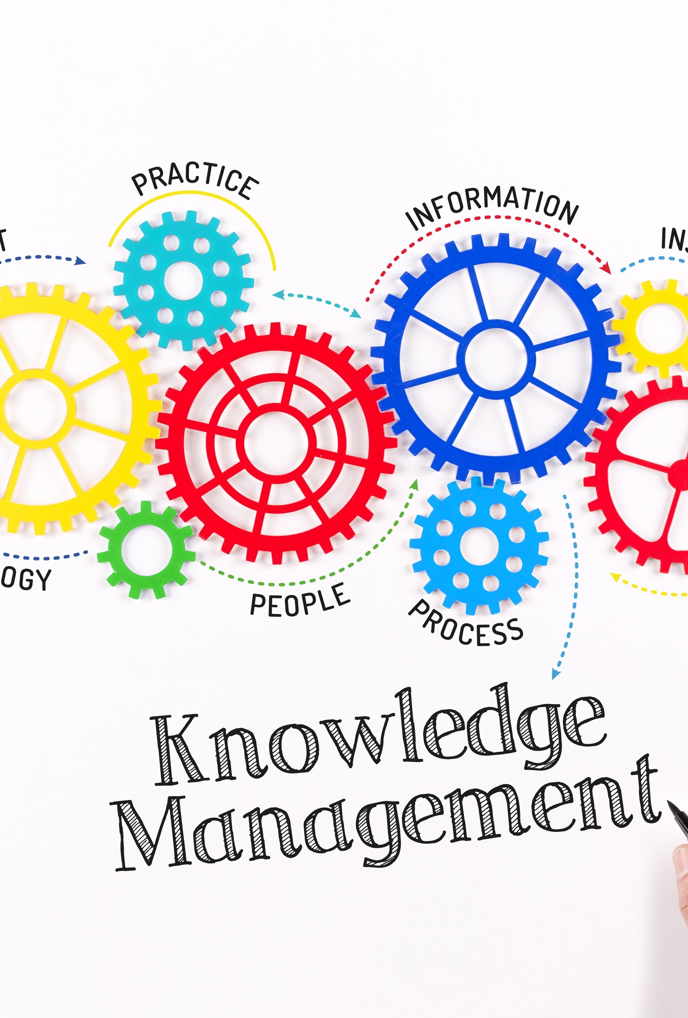
What is Confluence?
Content collaboration and knowledge management tool from Atlassian
Web-based
At its heart, a wiki
Rich text editor
Permissions scheme
Offers many integrations and extensions
Jira planning and tracking
Marketplace

Slide 3
Module Overview
Product options and common use cases for Confluence
Core Confluence concepts

Slide 4
Understanding Confluence Product
Options and Uses

Slide 5


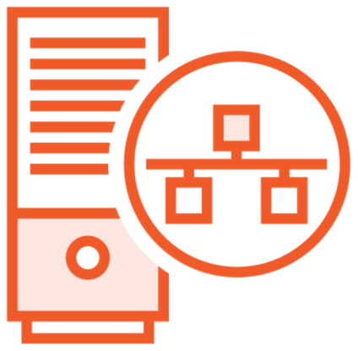
Confluence Product Hosting Options
The three primary ways to run Confluence
Confluence Cloud
Hosted and maintained for you by Atlassian in Atlassian Cloud.
Confluence Server
Self-hosted: you install and run yourself on premise or in the cloud.
Confluence Data Center
Confluence Server but clustered – run on multiple nodes.

Slide 6
Cloud and Server Primary Differences
Confluence Cloud
Atlassian hosts, secures, and maintains
Fast start-up No need to upgrade or patch Scales automatically
Your data is in Atlassian Cloud
Some limits to customization, configuration and extension
5000 user limit and more limited options for user management
Confluence Server
You self-host, secure, and maintain Takes some time to install and configure You must upgrade and patch
You must scale as usage increases
Your data in on premise or in your cloud More options for customization
No user limit, more user directory integration options including LDAP

Slide 7
Confluence Cloud is the easy button.

Slide 8



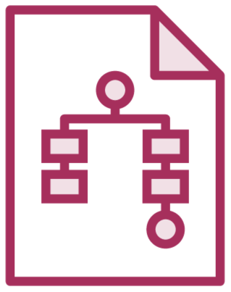


Common Uses
Internal technical and process documentation
Published documentation
Multi-tenancy – many teams or departments using a single instance
Single team / product information sharing
Knowledge base for customer support
Collaborative documentation between groups

Slide 9






Common Considerations
Who and how many will be using it and how will they login?
How much control do you need of the instance?
Will anonymous access be allowed for all or some spaces?
Will it be internally or externally facing, or both?
The primary ways in which it will be used?
Can the data be hosted in the cloud?

Slide 10
Understanding Confluence Core Concepts

Slide 11


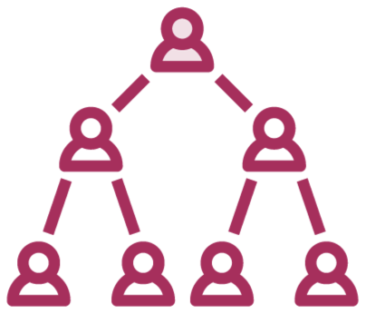

Confluence Concepts
Content
Users and Permissions
Content Categorization
Atlassian Cloud Concepts

Slide 12



Spaces
fitnesstracker Fitness Tracker Project
Spaces organize all content
Think of them as folders
Top-level, non-hierarchical
Carved Rock Team
Customer Call Handling
Contain pages and blogs
What spaces to create is an
important decision
Users can have personal
spaces
Multiple pages
A single blog
Have a name and a unique key
Can’t change key after space creation
Spaces can’t contain other spaces_{Jake}
Jake

Slide 13
Pages
Primary content type
- Rich text with WYSIWYG editor
Every space has a homepage Pages are hierarchical
Can have attachments
Home page

Slide 14


Blogs
Each space can have one blog
- Including a personal space
Blogs contain posts listed in chronological order
Used for sharing point in time information such as announcements or news

Slide 15



Attachments
Confluence is more of a wiki than a document storage tool
Attachment size is limited and large attachments could impact performance
There are work arounds with macros and add-ons
You can upload and attach files to any Confluence page or blog post
To display visual content
To provide a home for important files

Slide 16






Permissions and Users
Permissions determine what Confluence users can do
Permissions exist at the space,
site, and page level
Users can be assigned to
custom groups
Groups and individual users can be granted permissions
Site administrators and confluence administrators are
canned groups
Group
User
Permissions
Space
Site / Global
Page-level Restrictions

Slide 17



Content Categorization
Confluence provides labels and categories as a way to categorize and locate pages, attachments, and spaces.
Categories for spaces
A category is a string applied to one or more spaces – such as “team” or “finance_department.”
Labels for attachments
Labels can also be applied to attachments.
Labels for pages
Labels are strings that can be applied to individual pages in any spaces.

Slide 18
Atlassian Cloud Concepts
Organization
Top-level concept
Manages users, controls access to sites and products
Site
Maps to an Atlassian domain name
Can contain one of each Jira product and one of Confluence instance
Product
Jira Cloud, Jira Service Desk, Jira Core, or Confluence instance

Slide 19

Confluence is a feature-rich wiki collaboration product
Module Summary
Several product options available
Server, Cloud, and Data Center
Cloud is the easiest to get started
Learned the Core Concepts
Spaces, pages, blogs, attachments
Permissions and users
Page labels and space categories
Cloud organizations, sites, and products

